Slide 1
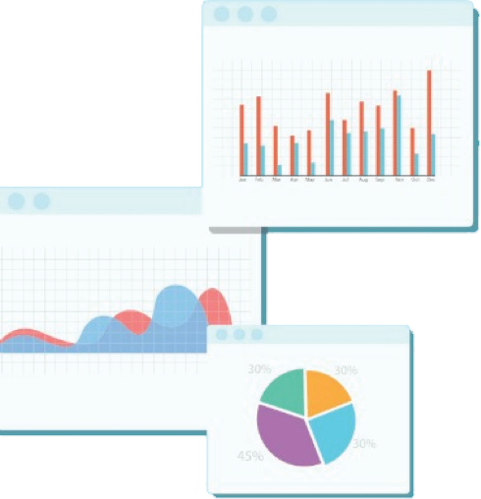


Welcome to Week 11
Lecture 2!
Data Science in Python &
Machine Learning

Slide 2
Announcement
Belt exam code will be given to the eligible students by tomorrow evening
Eligibility for belt exam : Week 9(including resubmits) and Week 10 assignments
You will be given belt color based on
Black Belt : Finishing exam in <24 hours and score >=9.5
Red Belt : Finishing exam in <24 hours and score>=8.0 and <9.5
Next week is your presentation week.
You will find out the order in class on Thursday so everyone must be ready!
You will have a max of 5 minutes (we will have a timer) so please practice!

Slide 3
Today’s Agenda
Overview of sequential models in Keras
Regularization Strategies
Discussion of Mock Belt Exam solution

Slide 4
Building
Neural Networks

Slide 5
Review of Neural Networks in Keras
A Keras model follows these main steps:
Instantiate the model type (Sequential for our models)
Add each layer in the order you want them to run
Each layer needs a number of nodes and an activation function
1st layer must have defined input size (input_dim=X_train.shape[1])
Last layer:
Nodes = 1 for regression or binary classification, OR the number of target classes for multiclass classification.
Activation must be appropriate to the problem.
Linear activation is a good choice for regression
Sigmoid for binary classification
Softmax for multiclass classification
Compile model
Loss appropriate for problem (MSE, BCE, or Categorical Cross Entropy
Optimizer
(optional) metrics appropriate for the problem type. You can find list of metrics here
Fit model
Training set
Validation set
Epochs

Slide 6


Making Predictions With a Multiclass Keras Model
When a Keras model makes a prediction it an array the length of the number of neurons in the output layer. If the final layers is Dense(1) then it returns one value, such as for regression or binary classification.
However if the final layer is Dense(3, activation=’softmax’) the model will return 3 numbers for each sample. With a ‘softmax’ activation, each number is the probability of that sample belonging to that class.
In order to use Scikit-Learn metric functions, we need one integer number for each sample, not 3 float numbers. For that, we use np.argmax(). This function will return the index number of the highest value.
We tell it ‘axis=1’ to tell it to look for the highest number along the columns, not the rows.

Slide 7
Kaggle competitions
Train data ( perform preprocessing and model building (Fit and Transform) )
Test data - It does not include target
Transform test data
Make predictions
Submit submission.csv to kaggle
It has specific format
to_submit = pd.DataFrame({'PassengerId': Test_df['PassengerId'], 'Survived': preds})
Make sure to use non processed column for the submission
If it gives the error about 1D data. You need to convert your preds into 1D using
preds.flatten()

Slide 8
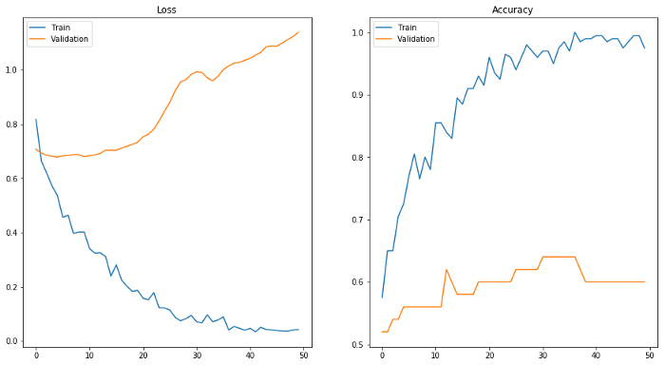
Tuning Neural Networks
Image Source

Slide 9
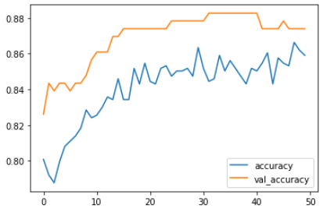
Underfitting (High Bias)
A model that is too simple or trained for too few epochs won’t learn to predict a dataset well.

Slide 10
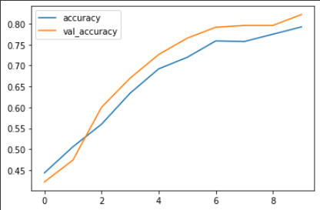
Underfitting (High Bias)
If model still seems to be learning:
Increase epochs
If learning has leveled off:
increase model complexity
Add nodes
Add layers

Slide 11
Overfitting (High Variance)
Neural networks are prone to overfitting
Several strategies are available to combat this:
Dropout Layers
Early Stopping
L1 and L2 Regularization
Decrease model complexity

Slide 12
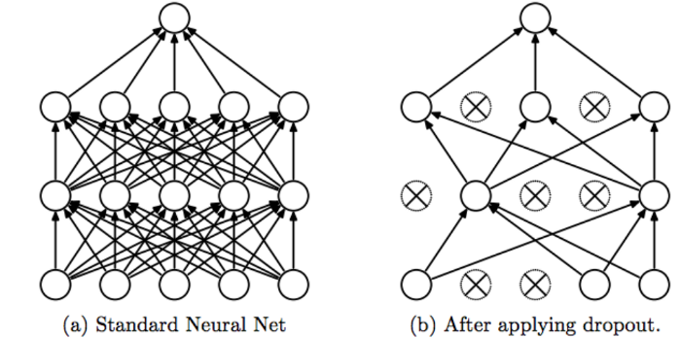
Dropout Layers
What it does:
A dropout layer ‘turns off’ nodes at random in the layer before fit. It turns off different nodes on each epoch.
Why it works:
A network can become overly reliant on a few particular nodes which pick up very specific patterns.
Dropout forces a network to distribute the learning across many nodes and find more generalizable patterns
Image Source:
Srivastava, Nitish, et al. ”Dropout: a simple way to prevent neural networks from
overfitting”, JMLR 2014

Slide 13
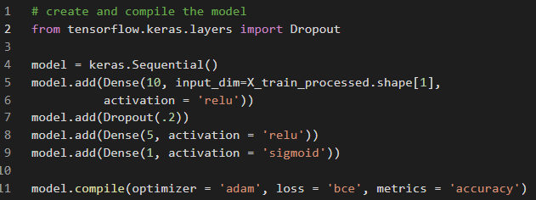
Dropout Layers
How to do it:
Portion of nodes to ‘drop’ on each epoch

Slide 14
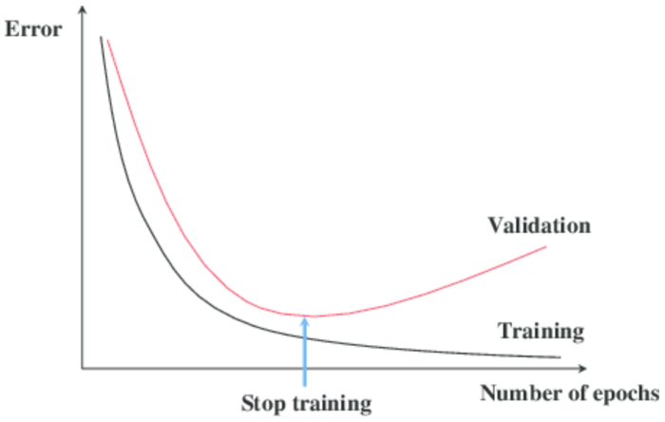
Callbacks: Early Stopping
What it does:
Callbacks are functions that can be called during training. They change something about the training between epochs.
Early stopping stops training early.
Why it works:
One source of overfitting is over-training. After a certain number of epochs a model will often begin to fit too tightly to training data. It learns TOO well. Early stopping stops the model before that can happen.
Image Source

Slide 15
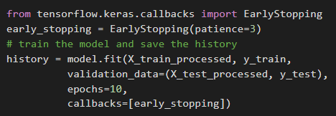
Callbacks: Early Stopping
List of callbacks in fit call (There are many other callbacks you can use!)
If no reduction in validation loss in 3 epochs, stop training
Image Source

Slide 16
Advanced Technique: L1 and L2 Regularization
What it does
Remember we said that a node in a neural network is like a linear regression model?
Just like linear regression, we can use L1 and L2 regularization to limit the change in weight values during learning by applying a ‘penalty’ term.
Why it works
One reason deep learning models can overfit, just a like linear models, is that certain weights get too large and the model puts too much emphasis on a small subset of features to the exclusion of others. Regularization forces the model to consider all features when learning and predicting.

Slide 17
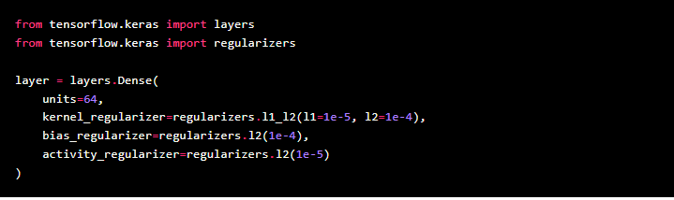
Advanced Technique: L1 and L2 Regularization
How to do it:
Image Source: Keras Documentation

Slide 18
Reduce Model Complexity
What it does:
Reduce the number of nodes and/or layers in your model.
Why it works:
One source of overfitting is a model that is too complex. An overly complex model will fit to the noise in the data rather than the true signal.
How it works:
Create a model with fewer nodes and/or layers.
(Remember to just change one thing at a time when experimenting)

Slide 19
Improving a Sequential Model in Keras
Make a copy and tune the classification model to improve it’s score on the testing set.
Strategies you might try:
More or fewer nodes
More or fewer layers
More or fewer epochs
Regularization
L1 or L2
Dropout layers
Early Stopping
Change activation functions or optimizers
Change batch size
Hint: Do you want to decrease bias, or variance first?
Which strategies will decrease which problem?

Slide 20
Today’s notebook
Mock Belt Exam

